Slide 1
Enhancing Search Engine Performance with Character N-Grams, Query Expansion and Named Entity Recognition
TASK: LongEval CLEF 2023 Lab
Team JIHUMING@UNIPD
Isil Atabek, Huimin Chen, Jesús Moncada-Ramírez
Nicolò Santini, Giovanni Zago

Slide 2

Agenda |
Introduction
Methodology
System Architecture
Experimental Setup
Results and Discussion
Conclusion

Slide 3
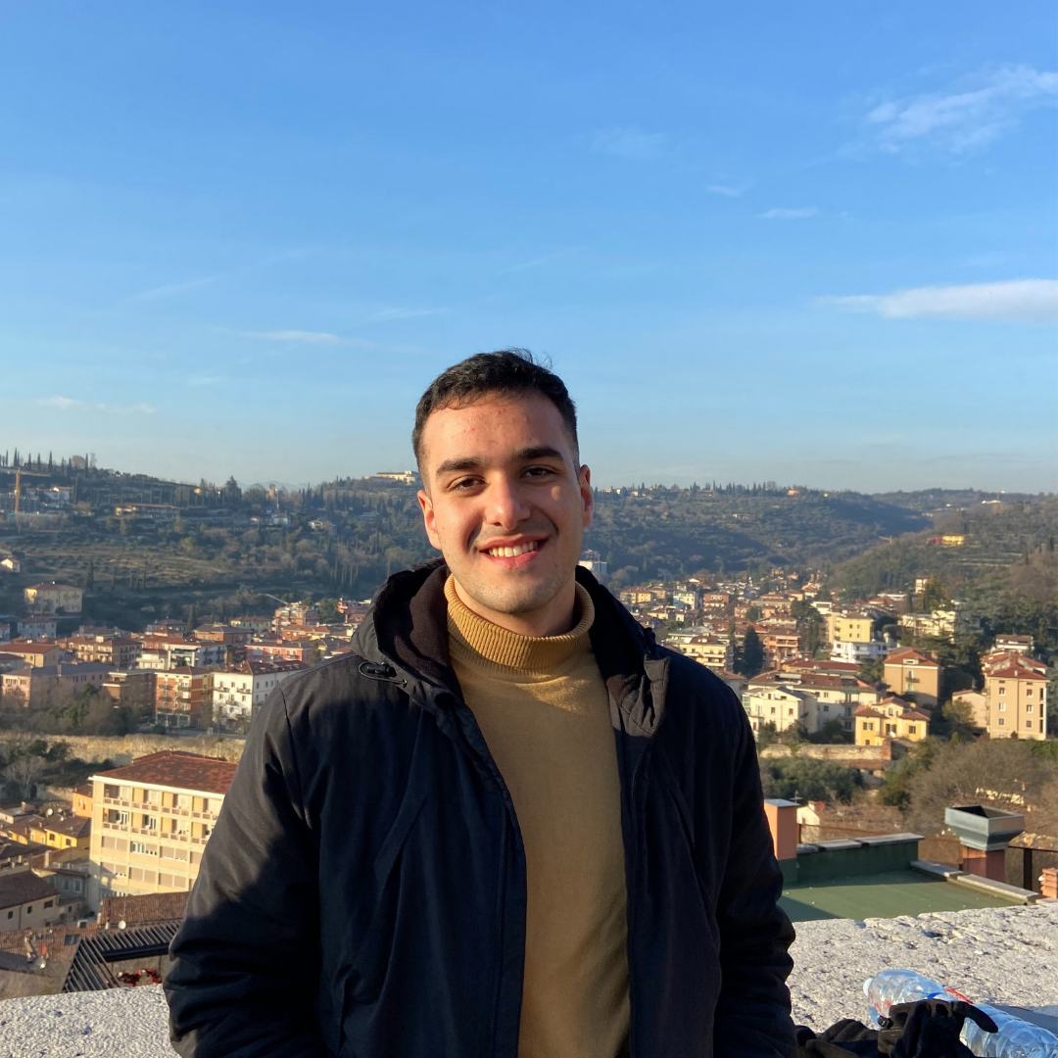

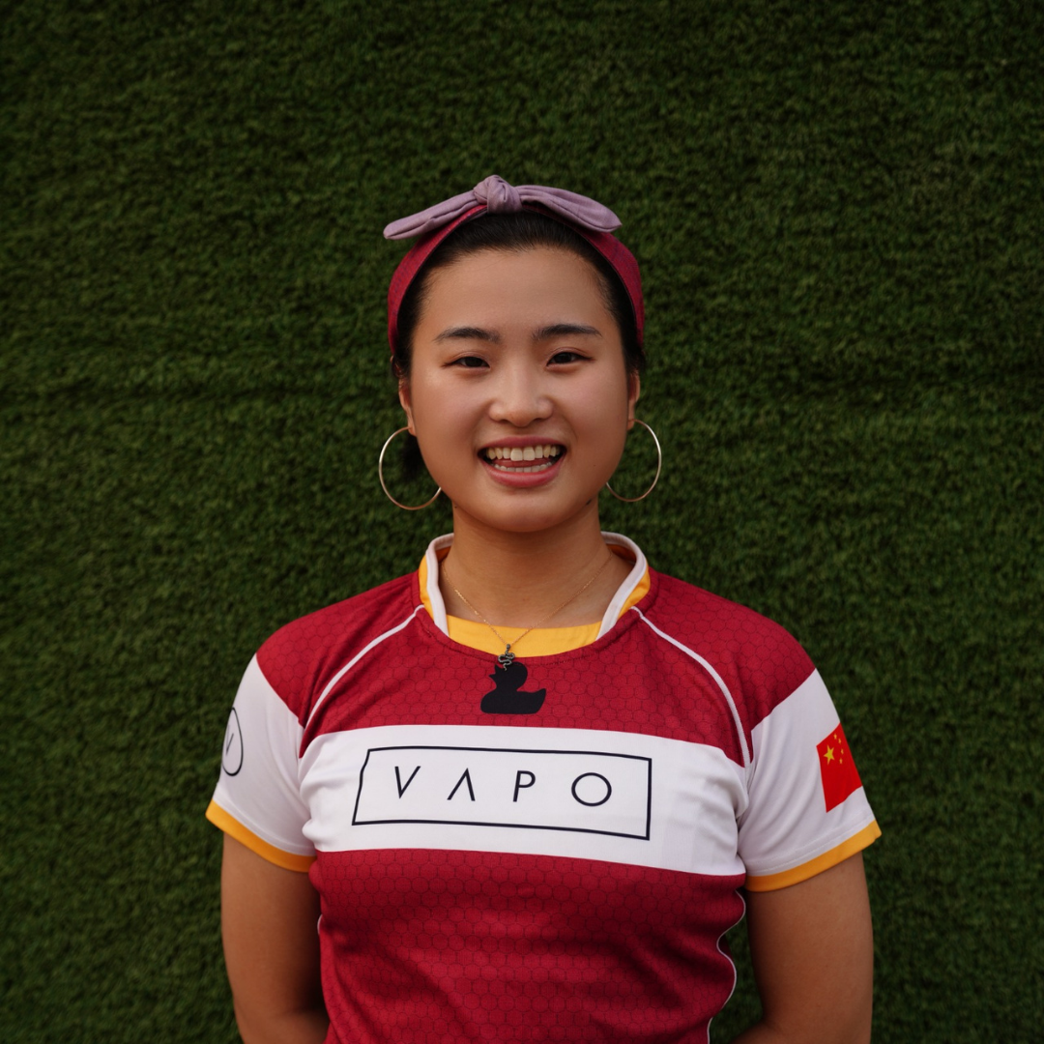


Our Team |
Jesús Moncada-Ramírez
Giovanni Zago
Huimin Chen
Nicolò Santini
Isil Atabek

Slide 4
Introduction |
We introduce a search engine for LongEval at CLEF 2023. Our system focuses on temporal performance in English and French documents.
By analyzing text and using NLP techniques, we refine our system. Implemented in Java with Lucene, we developed five top-performing systems based on MAP and NDCG scores.

Slide 5
Introduction |
Our approach involves analyzing English and French versions of the documents using whitespace tokenization, stopword removal and stemming.
We generate character N-grams to identify recurring word structures repeated over documents.
We use query expansion with synonyms and NLP techniques as NER to further refine our system.

Slide 6


Methodology | Parsing
Documents
Topics
JSON version.
Iterator/Iterable architecture.
TRECTopicReader not working.
Our own parser treating topic documents as XML documents.

Slide 7


Methodology | Index
Always (BM25)
FIELD 1
FIELD 2
FIELD 3
FIELD 4
(processed) English version
(processed) French version
Character N-grams of both versions
NER information
Apache OpenNLP
3-grams, 4-grams, 5-grams

Slide 8

Methodology | English
ENGLISH PROCESSING (ANALYZER)
Whitespace tokenization
Breaking based on special characters
Lowercasing
WordDelimiterGraphFilter
TERRIER stopword list
Query expansion with synonyms
Stemming
English Minimal Stemmer
WORDNET

Slide 9
Methodology | French
FRENCH PROCESSING (ANALYZER)
Whitespace tokenization
Breaking based on special characters
Lowercasing
WordDelimiterGraphFilter
French
stopword list
Stemming
French Minimal Stemmer

Slide 10
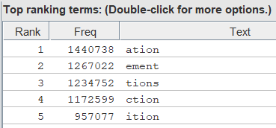
Methodology | N-grams and NER
N-GRAM GENERATION
NER GENERATION
Delete all characters except letters.
Generate char N-GRAMs.
Use the FRENCH documents.
NER about locations, person names and organizations.

Slide 11
System Architecture |
LongEval data structure (queries and documents), Document Parser and Topic Reader
Analysis techniques (tokenization, NER, N-Gram)
Index
Search engine

Slide 12
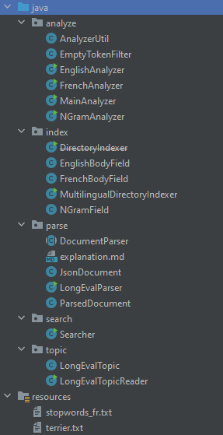
System Architecture |
Package division
Resource files (English and French stopwords)

Slide 13
System Architecture |
REMARKABLE CLASSES
Parse:
Reading documents in JSON format, in order to convert them in Java classes;
LongEvalParser is the class that implements DocumentParser (Iterator) and parses all documents.
Analyzer:
Applies the tokenization rules for both English and French documents (Lucene methods and stopwords files);
Generate character N-grams (Lucene).
Index:
Initially made by DirectoryIndex, which allowed only to index document with a certain language;
MultilingualDirectoryIndexer reads both English and French documents, indexing all documents;
Vocabulary statistics.

Slide 14
System Architecture |
REMARKABLE CLASSES
Topic:
Impossible to use TrecTopicsReader (Lucene) because the format of trec files was too poor;
Defines a Java class representing a topic;
Considers the .trec files as XML, parsing them using Java XML library.
Search:
Do the effective search (specifying analyzers, path of topics, path of index, …)

Slide 15
Experimental Setup | Overview
Goals:
Generate multilingual indexes
Perform runs over generated indexes and compare results
Evaluation:
MAP, NDCG and Rprec scores.
Two-Ways ANOVA analysis.
Tukey Honestly Significant Difference (HSD) test.

Slide 16
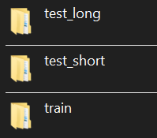

Experimental Setup | Indexes
We created indexes for TRAINING and TEST collections.
<date>_multilingual_3gram
<date>_multilingual_3gram_synonym
<date>_multilingual_4gram_synonym
<date>_multilingual_5gram_synonym
<date>_multilingual_4gram_synonym_ner
All of them are public in Google Drive.

Slide 17
Experimental Setup | Runs
We made 12 experiments over different configurations.
seupd2223-JIHUMING-01_en_en
seupd2223-JIHUMING-02_en_en_3gram
seupd2223-JIHUMING-03_en_en_4gram
seupd2223-JIHUMING-04_en_en_5gram
seupd2223-JIHUMING-05_en_en_fr_5gram
seupd2223-JIHUMING-06_en_en_4gram_ner
seupd2223-JIHUMING-07_fr_fr
seupd2223-JIHUMING-08_fr_fr_3gram
seupd2223-JIHUMING-09_fr_fr_4gram
seupd2223-JIHUMING-10_fr_fr_5gram
seupd2223-JIHUMING-11_fr_en_fr_5gram
seupd2223-JIHUMING-12_fr_fr_4gram_ner

Slide 18
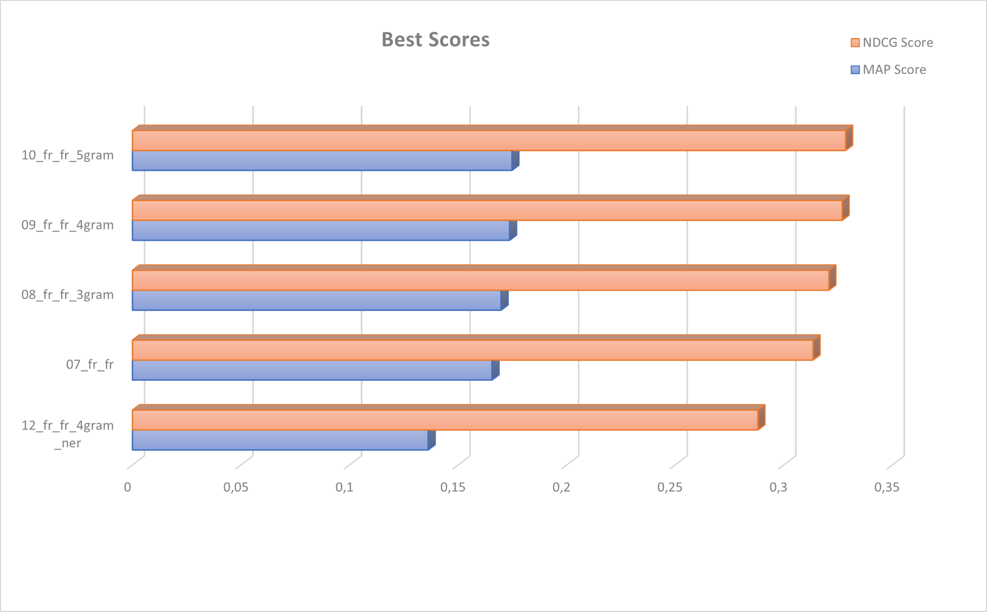
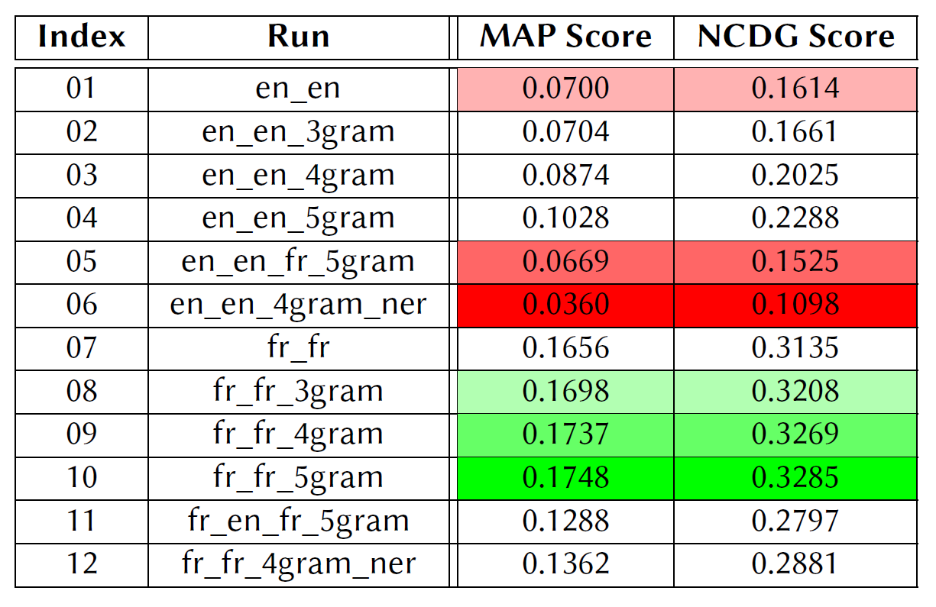
Results and Discussion | Train
Five best systems with five best scores
Fr_fr_5gram
Fr_fr_4gram
Fr_fr_3gram
Fr_fr
Fr_fr_4gram_ner

Slide 19
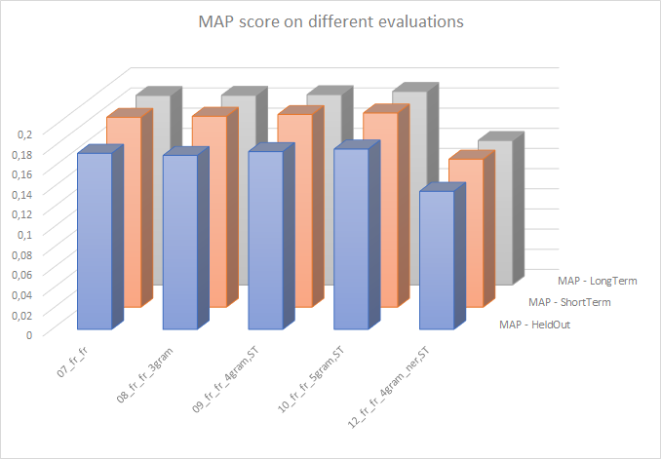
Results and Discussion | Test
Mean Average Precision (MAP) evaluating the effectiveness of an IR system in ranking documents/items.
Indicating same score ranks in three data sets.
Demonstrate the best performance at the long-term.

Slide 20
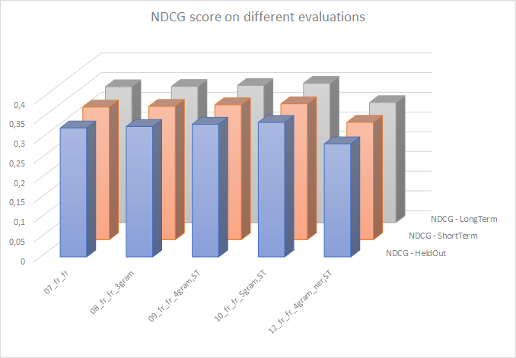
Results and Discussion | Test
nDCG (normalized Discounted Cumulative Gain) assesses the quality of the ranking produced by an IR system.
Indicating same score ranks in three data sets.
Demonstrate the best performance at the long-term.

Slide 21
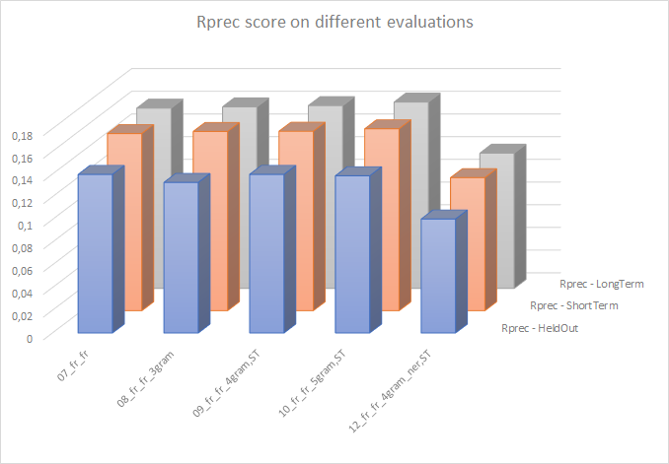
Results and Discussion | Test
Rprec (Rank Precision) measures the precision of the retrieved documents/items
Indicating same score ranks in three data sets.
Demonstrate the best performance at the long-term.

Slide 22
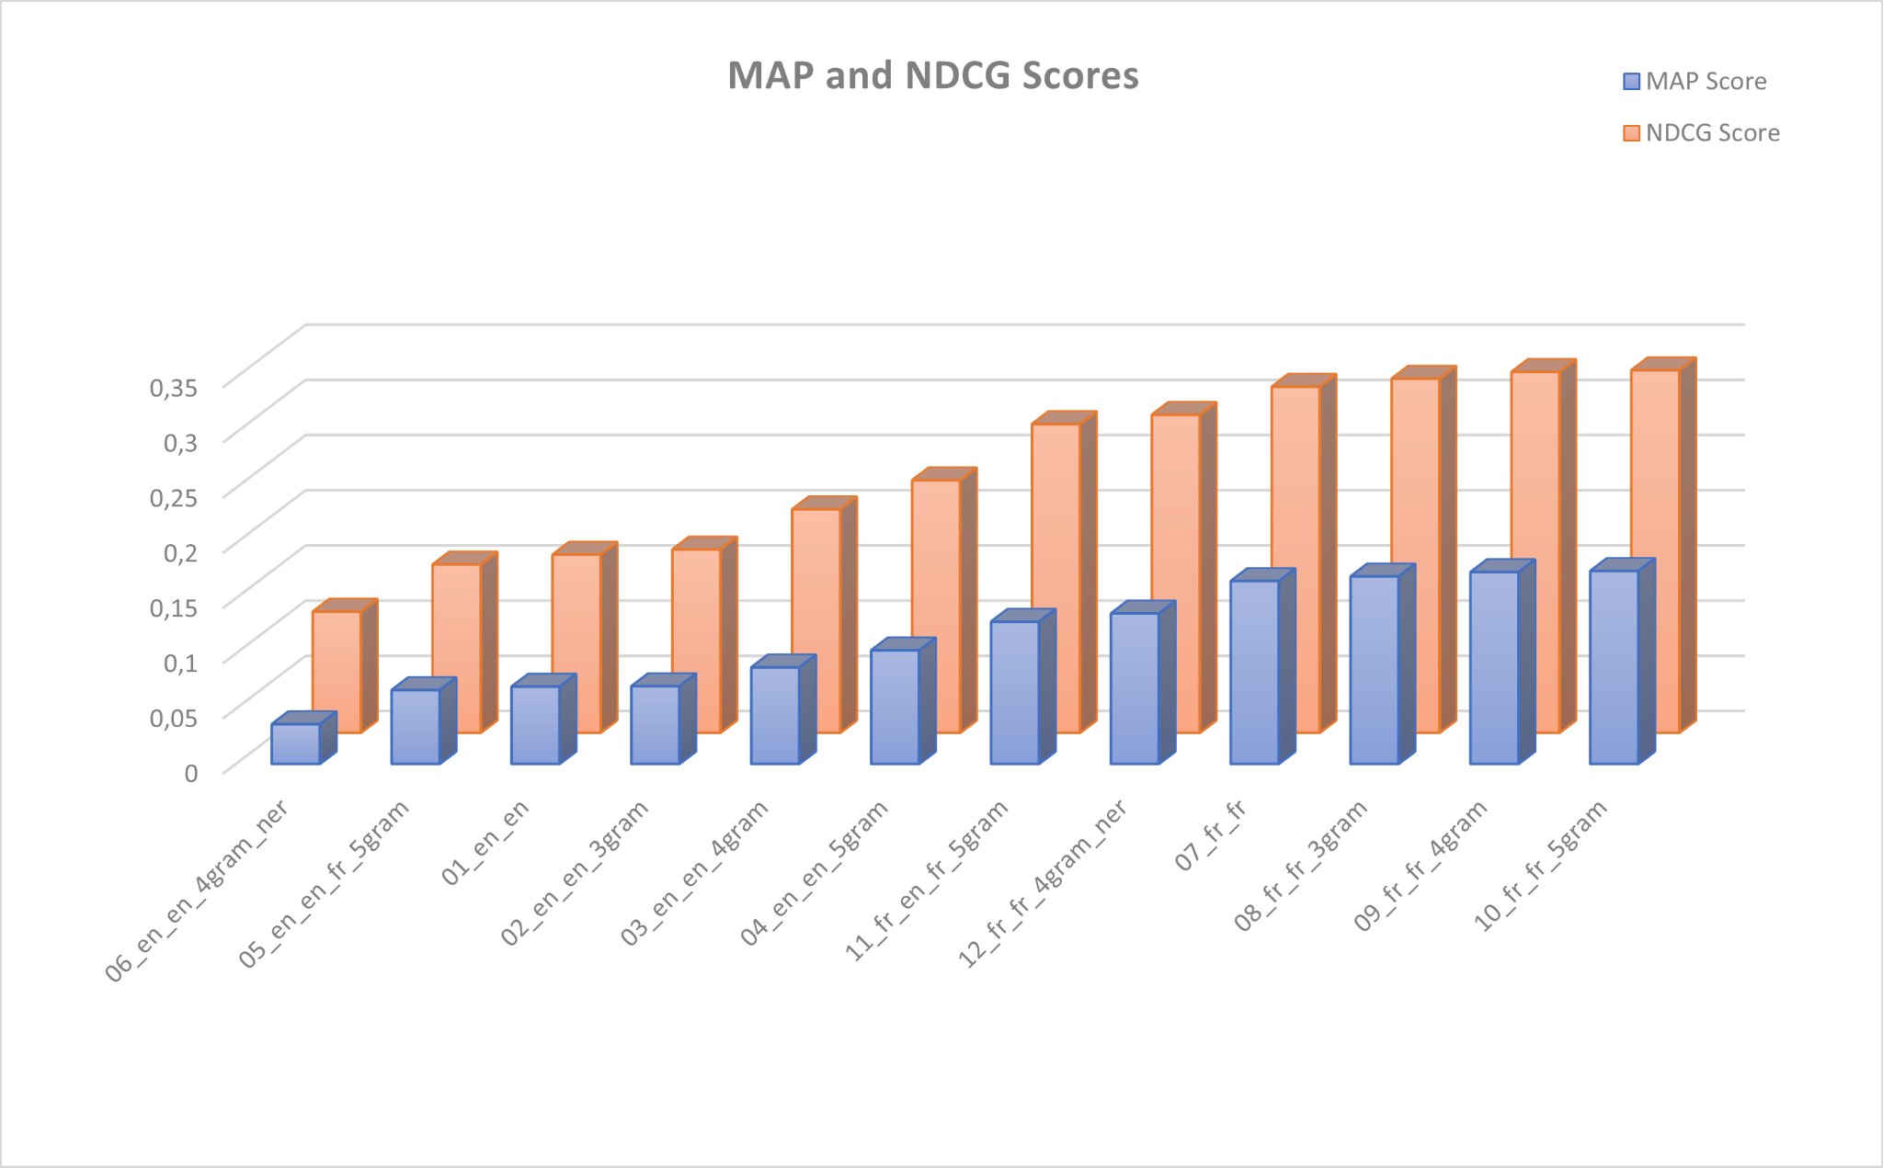
Results and Discussion | Train
French queries perform better than their English counterparts.
IR system’s effectiveness generally increases with a larger N-gram size.
The inclusion of NER in the indexing process has a negative impact on the scores.

Slide 23
Results and Discussion |
From the training data and test data, the three metrics shows the same rankings of five systems’ effectiveness
The long-term data presents the best performance score.

Slide 24

Conclusion |
Our results (MAP, NCDG, ANOVA etc) reflect our approach: many simple approaches, as if we were searching for a heuristic start of a more complex information retrieval. The only untapped approach would be including a machine-learning based IR system, to achieve a more adaptable one.

Slide 25
THANK YOU
Team JIHUMING@UNIPD
Isil Atabek
Huimin Chen
Jesús Moncada-Ramírez
Nicolò Santini
Giovanni Zago

